Slide 1
DSC 530 Final Project: Movie Analysis
Colin Michael
June 4th, 2022

Slide 2
Project Overview: Movies
I have always been extremely passionate about movies. I wanted to use data to analyze what makes a movie successful.
I used a dataset from IMDB of +1,700 movies, including the following variables:
IMDB User Rating (1-10)
Budget ($)
Number of Rating Votes
Length of Movie (minutes)
Year Released
Genre
My hypothesis is the budget will be the strongest predictor of IMDB User Rating

Slide 3
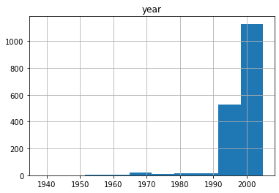
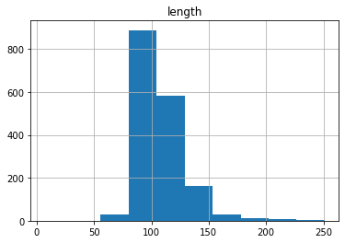
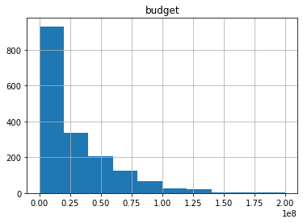
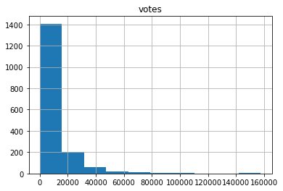
Data Distribution
I started by looking at how some of the key variables were distributed in my data set:

Slide 4
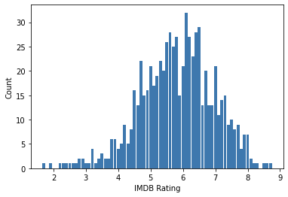
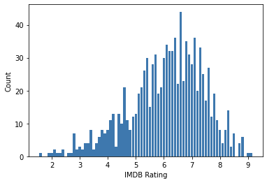
Genre Comparison
Comedy
Next, I wanted to compare IMDB ratings of comedy movies vs. non-comedy movies (comedy is my personal favorite genre):
Comedy movies generally have lower IMDB ratings than Non-Comedy movies.
Non-Comedy

Slide 5
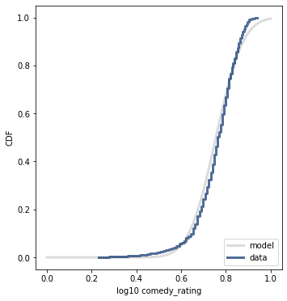
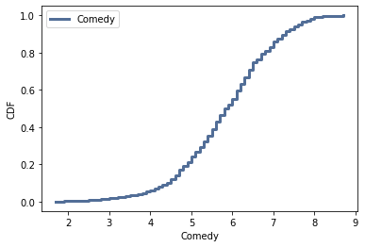
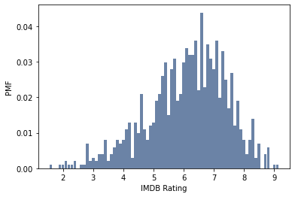
CMF, LoG, and PMF Analysis
I then wanted to look at CMF and Logarithmic visualizations for comedy movies, as well as a PMF distribution for all movies in my data set:
The log. model fits the actual data very well, except the left tail, where the lowest rated comedies are rated lower than expected.
The PMF distribution of the IMDB ratings shows the bulk of ratings concentrated around 5-7.5.

Slide 6
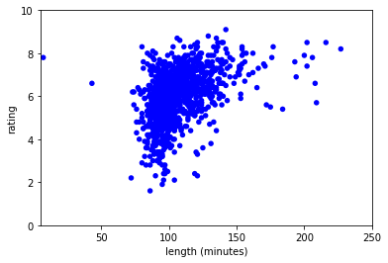
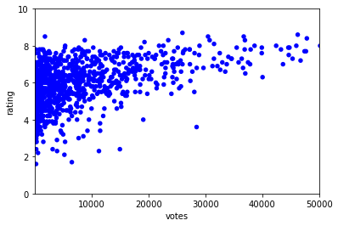
Scatterplot visualizations
I created scatterplots to illustrate the relationship movie length and rating, as well as number of votes and ratings.
The data shows a slight positive correlation between both length of movie and number of votes to IMDB rating.
This suggests that both longer movies and movies that receive more user-submitted votes tend to score higher on IMDB.

Slide 7
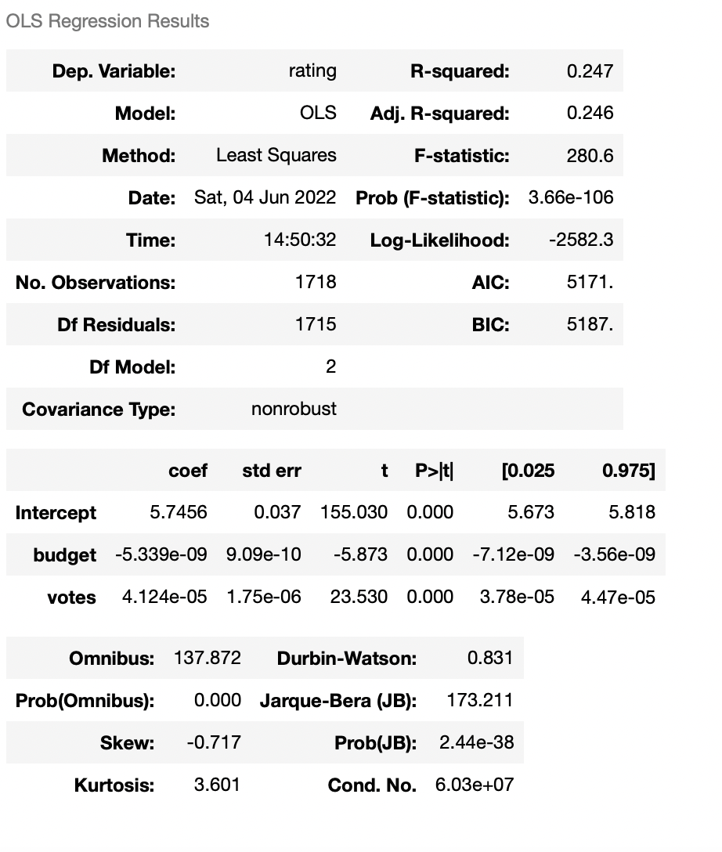
OLS Regression Analysis
Last, I conducted an OLS Regression with my data set. I used ratings as the dependent variable and budget and votes as the independent variables:
The model has a .247 R-Squared, meaning 24.7% of the variation in rating can be explained by budget and number of votes.
The P-scores of 0.000 allow us to reject the null hypothesis that budget and votes do not impact IMDB ratings.

